Slide 1

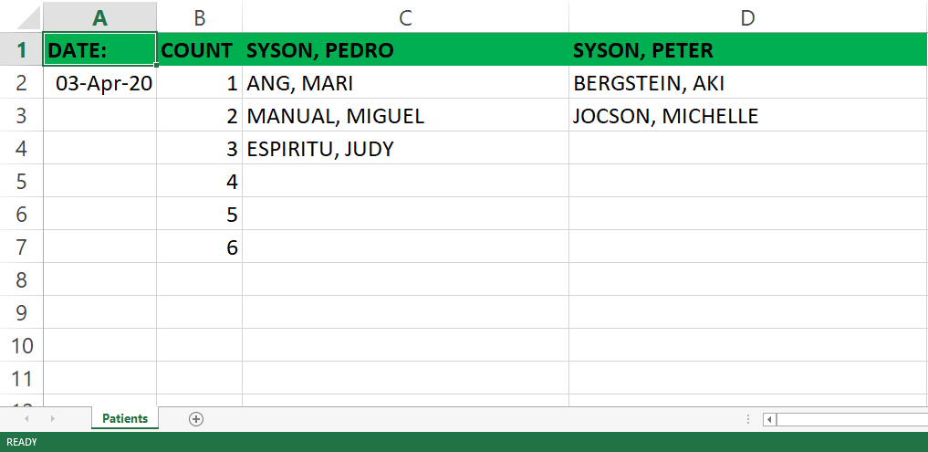
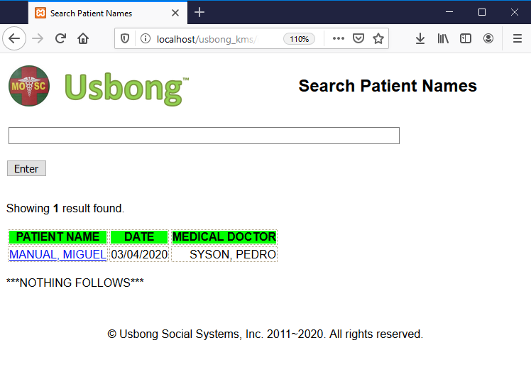
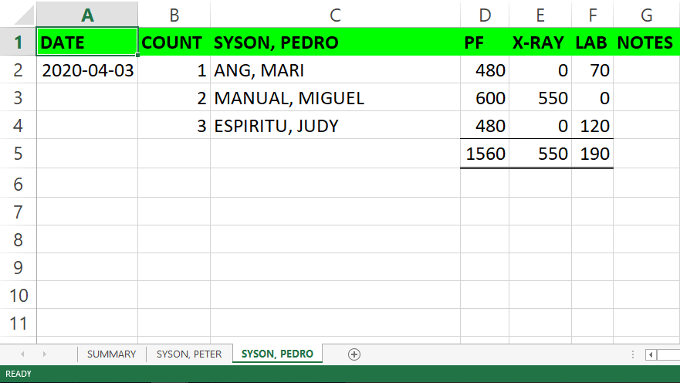
INFORMATION DESK
PC
TV
INTERNET
SEND/RECEIVE
X-RAY UNIT
BP
X-RAY MACHINE
SEND/RECEIVE
SEND/RECEIVE
SEND/RECEIVE
SEND/RECEIVE
SEND/RECEIVE
PC
TABLET
PC
SEND/RECEIVE
ACCOUNTING/CASHIER
TELEPHONES
LABORATORY FACILITY
PC
TABLET
PC
SEND
MICROSCOPE
PRINTER
PC
SEND
CASH REGISTER

